Slide 1
Education Technology Inquiry
By Alyssa Norman & Ayden Weber

Slide 2
How can we use technology to support students with disabilities and diverse learning needs in mathematics?

Slide 3
What is the relationship of your topic to teaching and learning?
-Students are diverse and require a diverse range of resources available to them for successful learning. As a teacher, it is important to be aware and knowledgeable about different resources in order to create an inclusive classroom environment.
-Assistive Technologies are a way in which teachers can improve learning in subjects such as mathematics for students of all learning capabilities.

Slide 4
What are Assistive Technologies?
-Assistive Technologies are “products that are designed to improve a student's functional capability or help a student succeed in accessing the general education curriculum”(Akpan & Beard 2014).
-Assistive technology can be used in two ways: to support learning and to bypass a challenging task such as handwriting. (Young, 2014)

Slide 5
What are the pros, cons, and risks?
Pros:
Allows students to be more independent (Akpan & Beard, 2014)
Increases students ability to actively participate in math activities (Akpan & Beard, 2014)
Can decrease stress and enhance success (Akpan & Beard, 2014)

Slide 6
Concept organizers, whether completed electronically or by hand, may contribute to better writing in students with learning disabilities (Young, 2014).
Calculators can help students with learning disabilities demonstrate their understanding of mathematical computations. Graphing calculators can provide additional support as they verify graph shapes and help solve algebraic equations(Young, 2014).
Text-to-speech software helps students to bypass the task of decoding words. Seeing individual words highlighted as the text is read aloud may help to improve students’ sight word vocabulary (Young, 2014).

Slide 7
Speech-to-text software bypasses the tasks of handwriting and spelling, allowing the student to concentrate on developing their ideas and planning their work(Young, 2014).
Computer-assisted instruction provides students with dynamic feedback (Young, 2014).

Slide 8
Cons:
-Some AT devices and services are financially unobtainable (most students with IEP’s do not receive funding) (Akpan & Beard, 2014)
-Educators acknowledge the potential of assistive technology, but they may feel overwhelmed by the responsibility of understanding and using this technology with their students (Young, 2014).
-Many teachers feel that they lack the knowledge and support to more fully integrate assistive technology into the curriculum (Young, 2014).

Slide 9
Risks:
Students, parents, and teachers need to become competent with the technology, as well as environmental factors that will continue to support the child in using technology(Young, 2014).
Lack of common vision, limited training, access to support services, insufficient funding, and lack of teacher time are commonly cited problems in regards to the implementation of assistive technology (Young, 2014).
In order to prevent the technology from being a distraction, students need to be taught how to use technology to support their learning (Young, 2014).
In order to be effective, assistive technology needs to be embedded within quality instruction (Young, 2014).

Slide 10
Videos:
Math Specific Assistive Technology

Slide 11
Ayden’s Video (Sumdog & ShowMe)

Slide 12
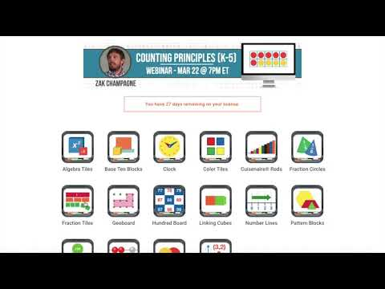
Alyssa’s Videos (Brainingcamp & Number Frames)

Slide 13
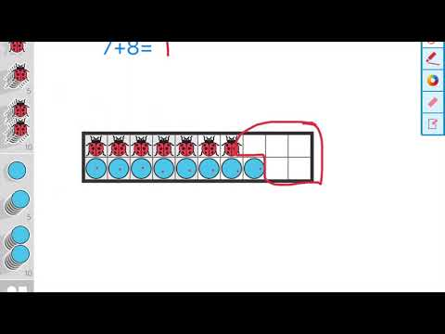

Slide 14
Other Math Specific Assistive Technologies:
Graphing calculators -Can solve complex equations, and the dynamic display screen allows the student to verify the results before solving on paper.
Park Math HD- Takes students through a mathematical adventure teaching, early math concepts based on Common Core State Standards. Learn numbers, counting, addition, subtraction, sorting, patterns and more through 7 fun, educational activities.
Animal Math- This app uses positive encouragement and cute characters to keep kids engaged in math activities. The free version of this application was having on counting to ten, patterns & sequences and addition to five.
A maths dictionary for kids- An animated, interactive online math dictionary that explains over 600 common mathematical terms in simple language.

Slide 15
Resources:
Akpan, J. & Beard, L. (2014). Assistive Technology and Mathematic Education. Universal Journal of Educational Research, 2(3). doi: 10.13189/ujer.2014.020303
Assistive Technology for Students with Learning Disabilities. (2018, May 04). Retrieved from https://www.ldatschool.ca/assistive-technology/
Harris, D. (2021) Digital Manipulatives. Brainingcamp. Retrieved from https://www.brainingcamp.com/
The Math Learning Centre. (2021). Number Frames (2.0.1) [Mobile application software]. Retrieved from https://apps.mathlearningcenter.org/number-frames/
Young, G. (2014). Assistive technology for Students with Learning Disabilities. LD@school. Retrieved from https://www.ldatschool.ca/assistive-technology/

